Slide 1


Security Attacks, Threats, Risks and Their Impact on Security Goals
Name : Amalraj P
Reg : 192524089
Course : Cryptography and Network Security
Course code : CSA5116
Faculty : Sudhagar D
Notes:
Welcome. Today: how attacks, threats and risks relate, and how each one damages the three core security goals: confidentiality, integrity and availability.

Slide 2
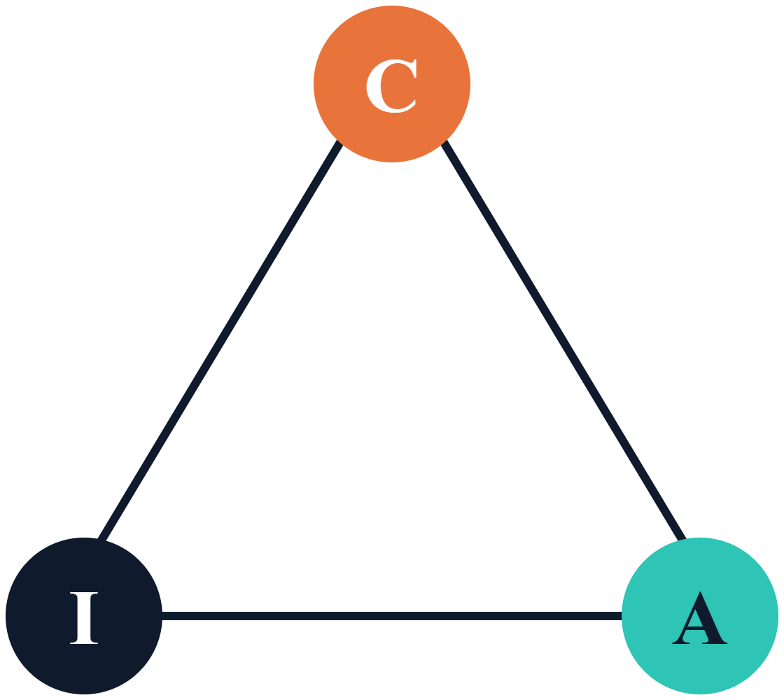
Security goals: the CIA triad
Confidentiality
Only authorized parties can read data. Tools: encryption, access control.
Integrity
Data is accurate and unaltered. Tools: hashes, signatures, MACs.
Availability
Systems and data are usable on demand. Tools: redundancy, backups.
2 / 10
Notes:
The CIA triad is the yardstick for every attack we discuss. Add authenticity, accountability and non-repudiation as extended goals. Every attack ultimately targets at least one corner of this triangle.

Slide 3
Threat, vulnerability, attack, risk
Term | Meaning | Example
Threat | Potential cause of harm | Ransomware gang
Vulnerability | Weakness that can be exploited | Unpatched server
Attack | Deliberate attempt to exploit it | Exploit run against server
Risk | Likelihood of loss times its impact | Likely outage costing $1M
3 / 10
Notes:
A threat only becomes an attack when someone acts. An attack only succeeds if a vulnerability exists. Risk is the business view: how probable and how costly. Controls reduce vulnerability or impact.

Slide 4
Threat categories (STRIDE)
Threat | Goal violated | Example
Spoofing | Authentication | Forged login or IP
Tampering | Integrity | Altered DB record
Repudiation | Non-repudiation | Denied transaction
Information disclosure | Confidentiality | Data leak
Denial of service | Availability | Traffic flood
Elevation of privilege | Authorization | User gains admin
4 / 10
Notes:
STRIDE is Microsoft's threat-modeling mnemonic. Walk each component of a system diagram and ask which of the six applies. It maps cleanly onto the security goals on the previous slides.

Slide 5
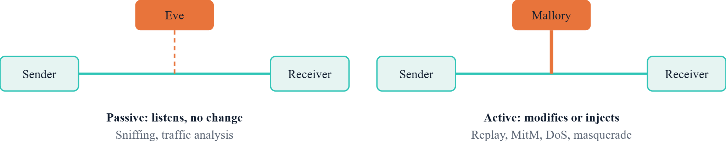
Passive vs active attacks
5 / 10
Notes:
Passive attacks are hard to detect, so we prevent them with encryption. Active attacks are hard to prevent completely, so we detect and recover using signatures, MACs, sequence numbers and monitoring.

Slide 6
Malware and social engineering
Malware
Social engineering
Virus/worm: self-replicating code
Trojan: disguised as useful software
Ransomware: encrypts data for payment
Spyware/keylogger: steals secrets
Phishing: fake emails and sites
Spear phishing: targeted at one person
Pretexting: invented scenario
Baiting: infected USB drives
6 / 10
Notes:
Malware attacks the machine; social engineering attacks the human. Most breaches start with phishing, which then delivers malware. Awareness training and email filtering are the main defenses.

Slide 7
Network and application attacks
DoS / DDoS
Man-in-the-middle
Flood a service with traffic until it cannot respond.
Relay and alter traffic between two parties.
SQL injection
Cross-site scripting
Untrusted input changes a database query.
Injected script runs in another user's browser.
7 / 10
Notes:
Network attacks exploit protocol trust; application attacks exploit unvalidated input. Mitigations: rate limiting and CDNs, TLS, parameterized queries, output encoding and a web application firewall.

Slide 8
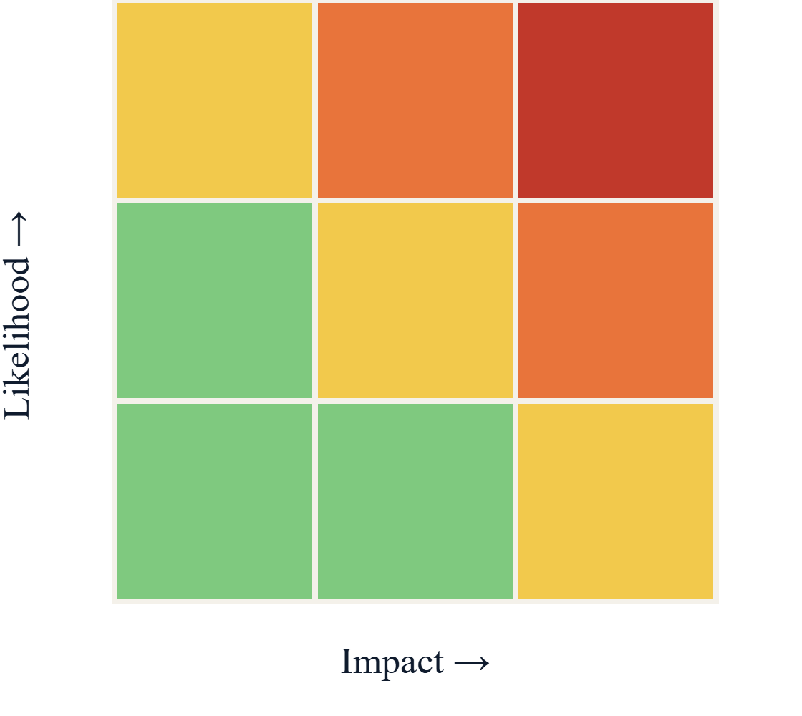
Risk = likelihood × impact
Everyday example
Phone left unlocked in a café: fairly likely to be picked up, very costly if it is. So you lock it.
Four ways to handle risk
Mitigate: add a control (firewall)
Transfer: share it (insurance)
Avoid: stop the activity
Accept: small risk, live with it
8 / 10
Notes:
Say: risk is how likely something bad is, times how bad it would be. Red cells first. Café phone example, then the four treatments. Optional numbers: 2 attacks a year at 5 lakh each is 10 lakh expected loss; a 2 lakh firewall that cuts attacks to 0.5 a year is worth buying. Qualitative matrices rank risks; quantitative methods use annualized loss expectancy: single loss times yearly rate. Prioritize the red cells first. Residual risk remains after controls and must be accepted by management.

Slide 9
Attack impact on security goals
Attack | Confidentiality | Integrity | Availability
Eavesdropping | ● | – | –
Man-in-the-middle | ● | ● | –
SQL injection | ● | ● | –
Ransomware | ● | ● | ●
DDoS | – | – | ●
9 / 10
Notes:
Use this table to reason about attacks: ask which corner of the triad is hit. Ransomware hits all three: data is read and exfiltrated, altered by encryption, and made unavailable.

Slide 10
Defense in depth: takeaways
Prevent
Detect
Respond
Encryption, patching, least privilege, MFA, input validation.
Logging, IDS/IPS, SIEM, integrity monitoring.
Incident plans, backups, forensics, recovery drills.
Know the threat, fix the weakness, measure the risk, protect C-I-A.
10 / 10
Notes:
Summarize: threats and vulnerabilities create risk; attacks damage C, I or A; layered controls prevent, detect and respond. Invite questions.

